Slide 1

AppDynamics & Vodacom CNE Pro-active Dashboarding

Slide 2

Introduction
CNE Overview Dashboard
Monitored Metrics
Health Rules
Data-Centre's Across South Africa
Alerting methodology

Slide 3
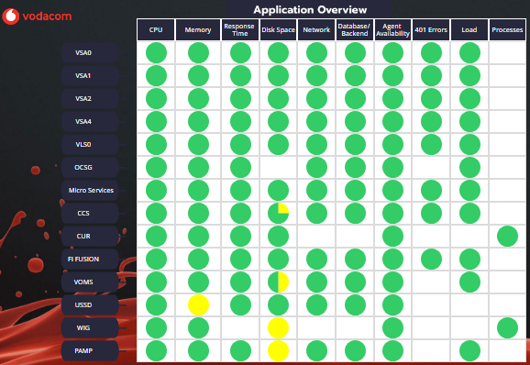
CNE Overview Dashboard
List of Core Network Engineering Applications
Monitored Metrics List
Each dot represents an App & the associated Metric

Slide 4










Monitored Metrics
Common metrics critical to identifying performance issues include CPU usage, Error rates, Response times, Request rates, User experience data/feedback
By monitoring resource utilization, an organization can optimize the use of application resources and ensure applications have the necessary resources to run efficiently and effectively
By monitoring resource utilization, an organization can optimize the use of application resources and ensure applications have the necessary resources to run efficiently and effectively

Slide 5
Performance monitoring measures response time and real-time application data to gauge application performance and identify issues, such as slow database queries, increased network latency and central processor unit (CPU) spikes, in a proactive manner.
Application monitoring includes monitoring of the entire application stack—application framework (e.g., Java or .NET), operating system, database, APIs, middleware, web application server, UI

Slide 6
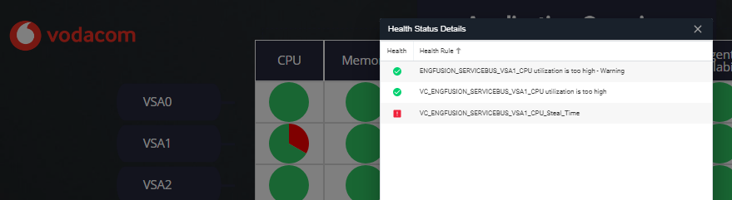
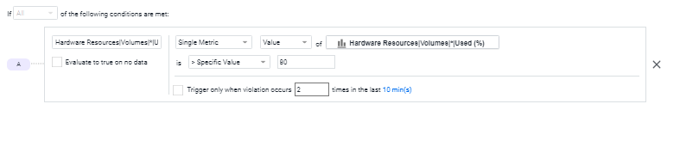
Health Rules
In this example CPU Utilization for VSA1 is in order
A Dot can represent several related health rules
But CPU Steal Time has breached a critical threshold
Monitored Metric / *Disk Volume Used%
Health Rules are based on clearly defined thresholds
The threshold > 80% in this example

Slide 7
Focusing on CCS we can see that a Disk Space health rule is currently violating

Slide 8
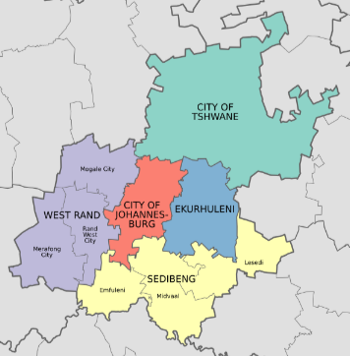




Redundant Data Center’s
CCS runs across 8 redundant sites *
* not exact locations

Slide 9
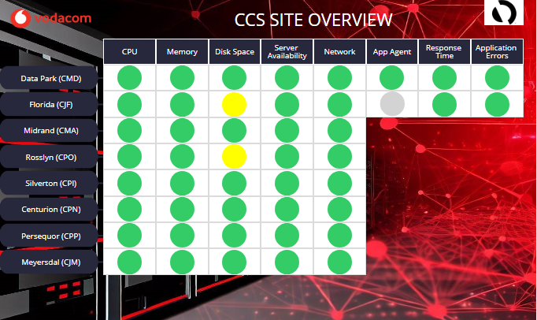
And utilizing a dashboard at a deeper level we can see where the disk issues lay

Slide 10








Alerting Methodology
It is vital for organizations to understand how their applications operate to ensure that applications meet expectations for performance, availability and overall end-user experience. This is achieved through application monitoring, and the use of application monitoring software.
Having the executive dashboards on display and frequently checking them has a positive effect on the teams responsible for the applications, issues can be identified before becoming critical, and customers are saved from any negative interactions.
The Alerts contain information about the metrics and thresholds breached, with options to have emails sent directly from the Appdynamics Platform or having a direct integration with our Ticketing System and dedicated NOC staff handling any critical events.
ASOC is able to send SMS’s as well as call the relevant System owners if deemed necessary, bringing down MTTR and keeping our customers satisfied.

